Slide 1
Planning for Transition from Pediatric to Adult Health Care for Youth with Mobility Limitation
Todd C. Edwards, PhD, Janice F. Bell, PhD, MPH, Donald L. Patrick, PhD, MSPH
University of Washington
Dept. of Health Services
American Public Health Assoc. Annual Mtg.
Denver -- November 8, 2010

Slide 2
Disclosure
Todd C. Edwards
No relationships to disclose

Slide 3
Learning Objectives
Discuss the health care transition issues facing youth with mobility limitation.
Explain associations between mobility limitation and measures of transition planning.
Describe components of medical home that are associated with transition planning.

Slide 4
Background
Health care transition increasingly significant issue (Kennedy, 2008)
  More young people with chronic illness and disability moving to adulthood
  Health care delivery more complex
Many young adults with special healthcare needs know little about health care transition (Lotstein, 2008; McManus et al., 2008)
  more than one-half feel they are not prepared when they transfer to adult care

Slide 5
Background (cont.)
In the 2007 National Survey of Children with Special Health Care Needs, 28% of youth with mobility limitation ages 0-17 years (n=5,162) had a medical home, compared with 47% of youth with all other special health care needs (n=31,708) (Bell et al., in prep).
No studies: Is medical home is positively associated with health care transition planning for youth with mobility limitation?

Slide 6
Study Objectives
Test associations between mobility limitation and transition planning, including receipt of health care advice.
Examine whether specific components of medical home are associated with transition planning.

Slide 7
Data Source and Sample
National Survey of Children with Special Health Care Needs, 2005–2006 (parent-report)
Youth ages 12–17 years
Receiving health care from pediatric provider only
n=18,179

Slide 8
Study Variables: Mobility Limitation
Defined as restrictions in function/activity rather than by diagnostic category (WHO ICF, 2001):
  “Compared to other children of the same age, does the child experience difficulty with coordination or moving around, such as walking or running?” (NS-CSHCN)
Includes congenital conditions (e.g. spina bifida), disease-related impairments (e.g. juvenile arthritis) and other causes (e.g. cerebral palsy, spinal cord injury)

Slide 9
Study Variables: Medical Home
Binary (no, yes) based on algorithm developed by the Child and Adolescent Health Measurement Initiative (CAHMI)
Five components:
  Personal doctor or nurse
  Usual source of care
  Accessible
  Family-centered
  Coordinated

Slide 10
Study Outcomes: Transition Planning and Health Care Transition Advice
Transition Planning: Meets criteria for receiving services necessary to making transition to all aspects of adult life, including health care, work, and independence
Health Care Transition Advice:
Provider discussed shift to an adult provider, if necessary;
Provider discussed future health care needs, if necessary;
Provider discussed future health insurance care needs, if necessary;
Provider encouraged youth to engage in age-appropriate self care (ages 13-17 only)

Slide 11
Covariates
All analytic models controlled for variables expected to confound relations between mobility limitation and transition planning
Sex, Age, Race/ethnicity
Census region
Family structure
Family income (% federal poverty line)
Health insurance status
Highest education anyone in household
Severity of the youth’s condition
Youth prescription drugs
School absences prior year

Slide 12
Statistical Analysis
Cross-sectional analysis of associations between mobility limitation, medical home, and transition planning
Logistic regression, controlling for covariates
  With and without medical home
  Stratified by mobility limitation
  Survey-weighted estimates
Stata (College Station, TX) Version 10.1

Slide 13
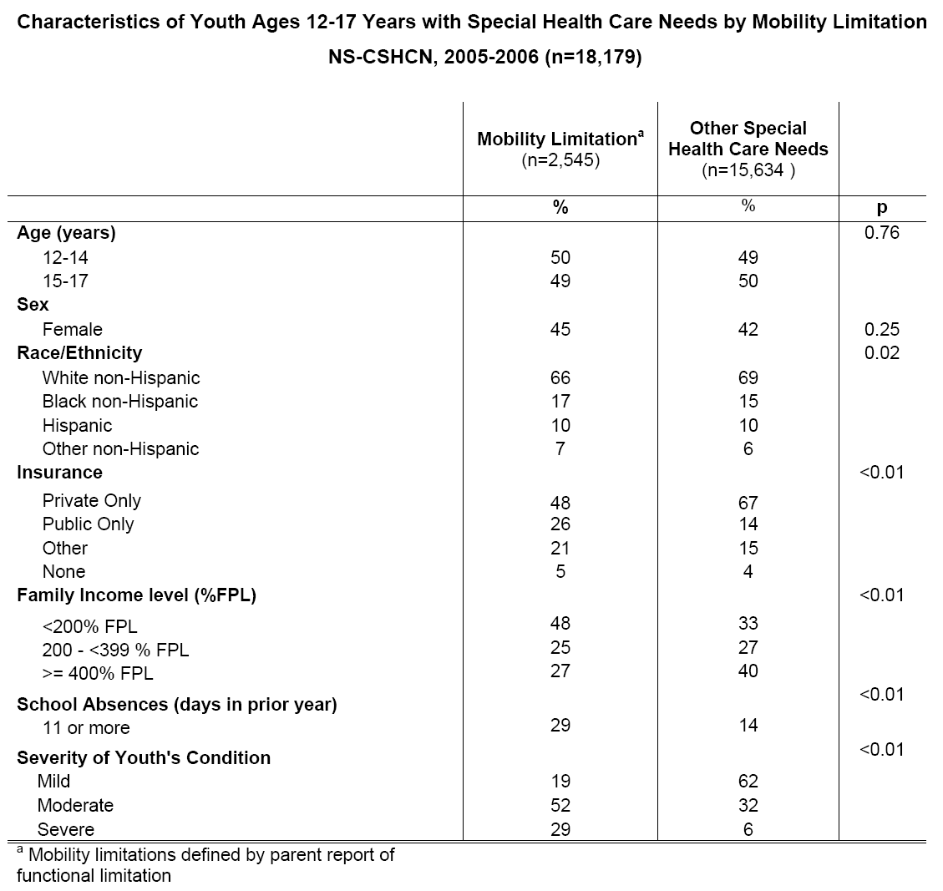

Slide 14
Results: Receipt of Pediatric Care Only
Youth with mobility limitation (65%) were more likely than those with other special health care needs (59%) to report that their medical provider treated children only:
Adjusted Odds Ratio = 1.28; 95% CI: [1.07, 1.53]

Slide 15
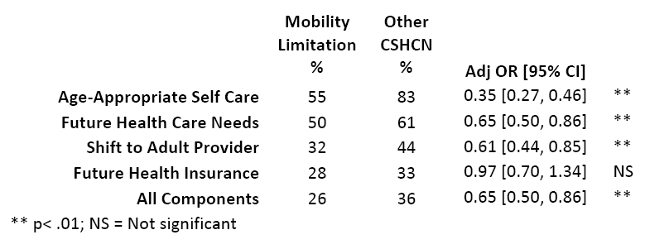
Transition Planning and Advice in Mobility Limitation and All Other CSHCN

Slide 16
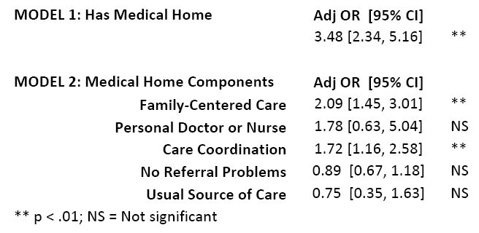
Youth with Mobility Limitation:
Medical Home and Transition Planning

Slide 17
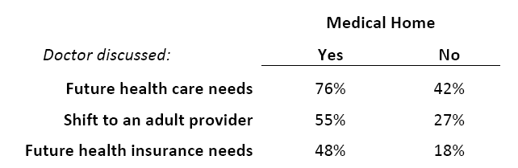
Youth with Mobility Limitation:
Medical Home and Receipt of
Transition Planning Advice

Slide 18
Summary
Youth with mobility limitation in pediatric care are less likely to receive transition planning advice than are other CSHCN.
Care in a medical home is associated with receipt of transition planning advice in this population.

Slide 19
Summary (cont.)
For youth with mobility limitation, family- centered and coordinated care is important for planning the transition from pediatric to adult health care.
Having a personal doctor or nurse or a usual source of care is not sufficient by itself for transition planning.

Slide 20
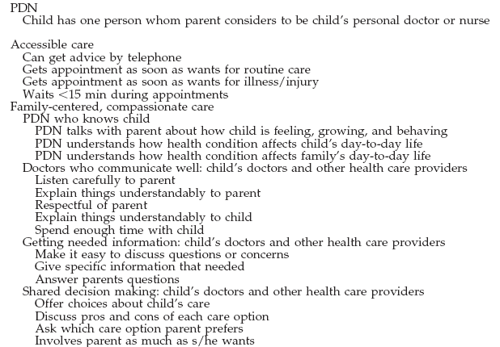

Slide 21
